Slide 1
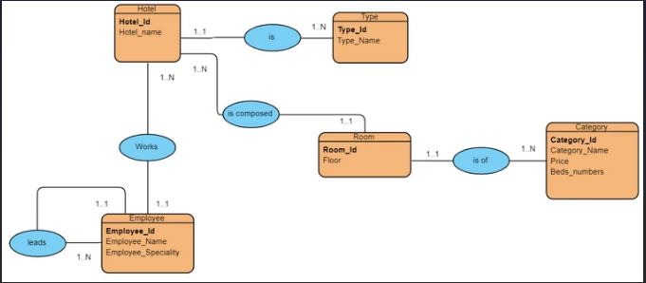
Hotel (Hotel_Id, Hotel_name, #type_id) Type (type_id, type_name) Employee (Employee_Id, Employee_Name, Employee_Speciality, #Hotel_Id, #Leader_id) Room (Room_id, Floor,#Hotel_Id,#Category_id) Category (Category_Id, Category_Name, Price, Beds_numbers)

Slide 2
Hotel
Room
Hotel_id
Hotel_Name
#Type_id
Room_id
Floor
#Hotel_id
#Category id
Category
Category id
Category_Name
Price
Beds_numbers
Employee
Employee_id
Employee_Name
Employee_Specility
#Hotel_id
#Leader_id
Type
Type_id
Type_Name

